Slide 1
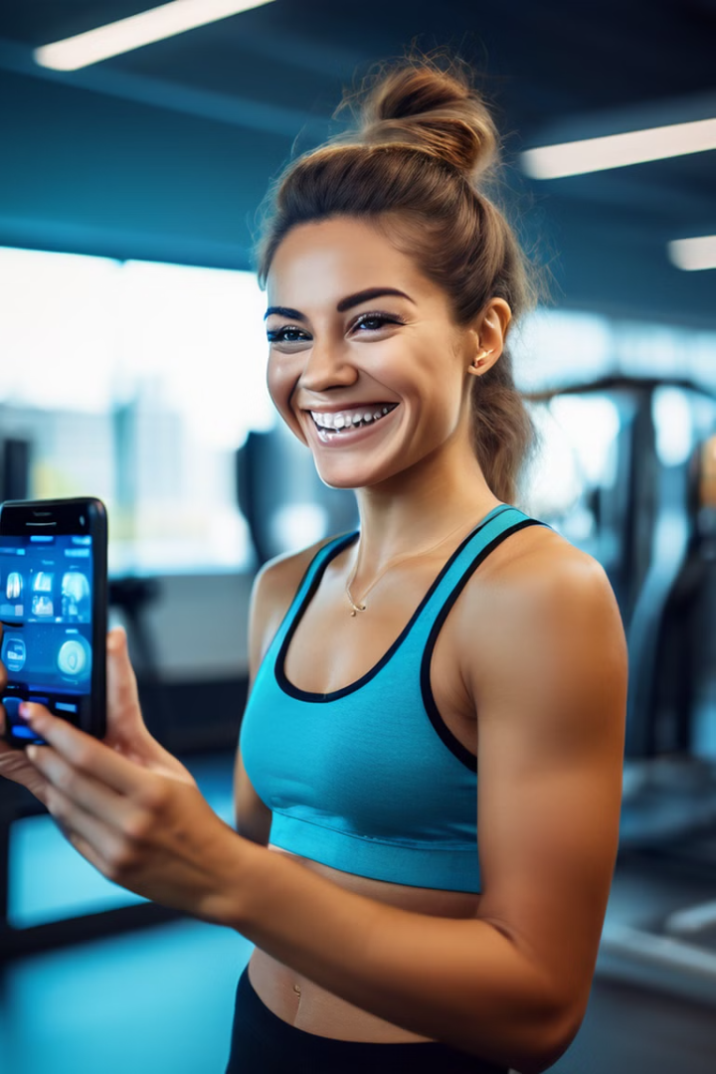

Welcome to FitSense
Welcome to FitSense, where your fitness journey begins! Discover personalized solutions to crush your goals and unlock a healthier, happier you!
by Kunwar Gaurav Singh

Slide 2
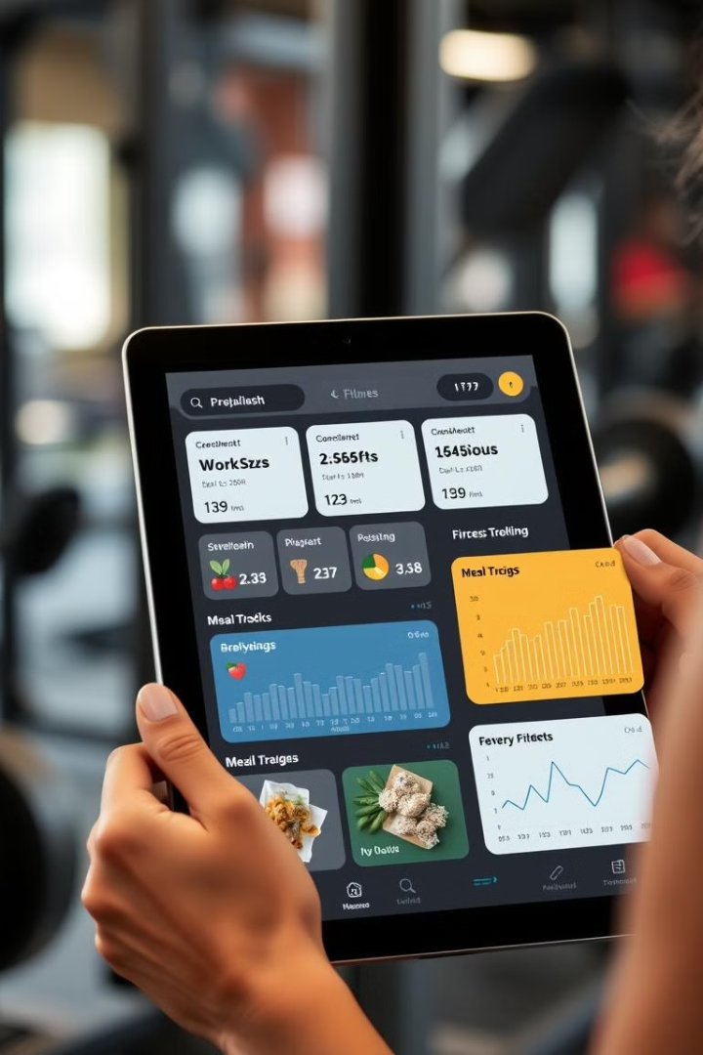
FitSense is your ultimate partner in achieving optimal fitness and form.
Our platform combines advanced posture detection technology with personalized exercise guidance called Guide bot to help you reach your fitness goals efficiently and safely. Whether you’re a beginner or a seasoned athlete, FitSense provides detailed posture analysis to ensure you perform each exercise with precision. Discover a smarter way to train and enhance your performance with FitSense—where technology meets fitness excellence. We offer a comprehensive suite of tools and resources to support you on your journey, including interactive chatbots, fitness calculators, and advance posture detection technology

Slide 3

Chatbot: Your Virtual Fitness Companion
Personalized Guidance
Workout Programs
Nutritional Advice
Our AI-powered chatbot provides personalized guidance and support throughout your fitness journey. It answers your questions, provides workout recommendations, and motivates you to stay on track. With its 24/7 availability, you can get the support you need anytime, anywhere.
The chatbot can help you create customized workout programs based on your fitness level, goals, and preferences. It can also offer suggestions for new exercises and workouts to keep your routine fresh and engaging.
The chatbot can provide personalized nutritional advice, helping you make healthy food choices that support your fitness goals. It can also offer meal planning tips and recipes, making it easier to stick to a healthy diet.

Slide 4
Fitness Calculators: Reach Your Goals with Precision
Body Mass Index (BMI)
Calorie Intake
protien Intake
Calculate your BMI to understand your weight status and identify potential health risks. This calculator provides a personalized assessment based on your height and weight.
Determine your daily calorie needs based on your age, gender, activity level, and fitness goals. This calculator helps you create a sustainable calorie plan for weight management or muscle gain.
Analyze your protein, to find the perfect balance for your body and fitness goals. This calculator helps you fine-tune your diet for peak performance and results.

Slide 5
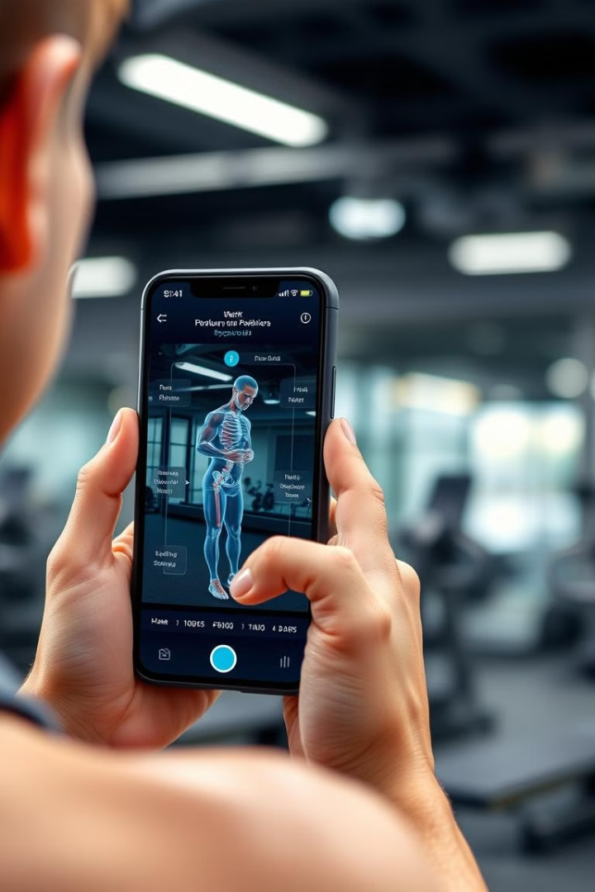



Advanced Posture Detection: Improve Your Form, Prevent Injuries
Real-time Feedback
Our advanced posture detection technology provides real-time feedback on your form during workouts. It analyzes your movements and identifies any imbalances or errors that could lead to injury.
More Features for Your Fitness Journey
FitSense goes beyond generic workouts - our posture analysis technology provides you with customized Droid cam feature and also a video upload feature.
Injury Prevention
By identifying and correcting poor posture, our technology helps prevent injuries related to improper form and overuse. It promotes a safer and more effective workout experience, allowing you to reach your goals without compromising your health.

Slide 6


Future Expansion: Elevate Your FitSense Experience
Enhanced Features
Unlock the potential of FitSense with upcoming additions like a secure login system, advanced chatbot integration, and expanded exercise options for posture detection.

Slide 7

Thank You

